Slide 1
Leaf disease identification for farmers using Deep Learning
Guided by:
Dr. Udit Narayana
Submitted by:
Cherukuri Roopa Chowdary (19bce7049)
Allu Meghana Chowdary (19bcd7105)

Slide 2
Contents Discussed
Tomato Leaf diseases considered
CNN technique
Methodology
Presentation
Literature survey
Test cases
Timeline

Slide 3
Tomato Leaf Diseases
Appearing as tiny, round splotches on the leaves, this tomato disease known as Septoria lycopersici typically starts on the lowest leaves first. The spots have dark brown edges and lighter centers, and there are usually many spots on each leaf. Infected leaves eventually turn yellow and then brown, and fall off.
Some of the tomato leaf diseases considered are
Tomato – Late_blight
Tomato – Leaf_Mold
Tomato – Septoria_leaf_spot
Tomato – Target_Spot
Tomato – Tomato_mosaic_virus
Tomato – Tomato_Yellow_Leaf_Curl_Virus
Tomato – Two-spotted_spider_mite
Tomato – Bacteria_Spot
Tomato – Early_Blight
Tomato – Healthy

Slide 4
CNN technique
CNN is a type of artificial neural network, which is widely used for image or object recognition, classification and tasks that involve the processing of pixel data.. Deep Learning thus recognizes objects in an image by using a CNN. It can also classify audio and signal data
A CNN's architecture is analogous to the connectivity pattern of the human brain. Just like the brain consists of billions of neurons, CNNs also have neurons arranged in a specific way.
A CNN can have multiple layers, each of which learns to detect the different features of an input image. A filter or kernel is applied to each image to produce an output
At each successive layer, the filters increase in complexity to check and identify features that uniquely represent the input object.
With convolution, the input image goes through a set of these filters. As each filter activates certain features from the image, it does its work and passes on its output to the filter in the next layer.

Slide 5
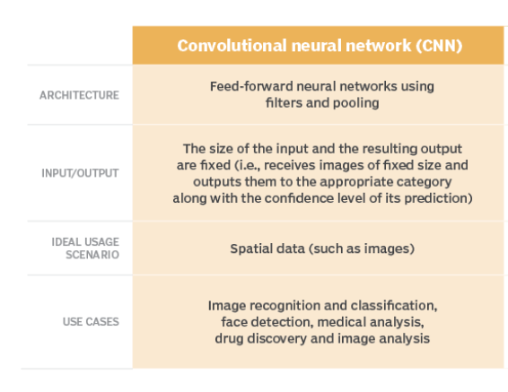
HOW CNN WORK?

Slide 6
Methodology
Libraries used- numpPy , pandas, TensorFlow, Scikit-learn, matplotlib
Flask framework is used to develop web applications using python for built-in development server and a fast debugging.
Convolution is applied to the input data to filter the information and produce a feature map.
The filter goes over the input image, doing matrix multiplication element after element. The result for each receptive field (the area where convolution takes place) is written down in the feature map.
It is responsible for recognizing features in pixels.
Next comes the pooling layer where it summarises the features present in a region of the feature map generated by a convolution layer.
The pooling used here is Max pooling where pooling operation selects the maximum element from the region of the feature map covered by the filter. Thus, the output after max-pooling layer would be a feature map containing the most prominent features of the previous feature map.
Followed by this is the Flattening layer that is used to convert all the resultant 2-Dimensional arrays from pooled feature maps into a single long continuous linear vector which is fed as an input to classify the image.
Next full connection layer is applied where each neuron in the fully connected layer corresponds to a specific feature that might be present in an image. The value that the neuron passes on to the next layer represents the probability that the feature is contained in the image.

Slide 7
Literature survey
Title | Abstract | Author
Rethinking the inception architecture for computer vision | Convolutional networks are at the core of most state-of-the-art computer vision solutions for a wide variety of tasks. Although increased model size and computational cost tend to translate to immediate quality gains for most tasks, computational efficiency and low parameter count are still enabling factors for various use cases such as mobile vision and big-data scenarios. | Christian Szegedy, Vincent Vanhoucke, Sergey Ioffe, Jonathon Shlens, Zbigniew Wojna

Slide 8
Title | Abstract | Author
ImageNet classification with deep convolutional neural networks | We trained a large, deep convolutional neural network to classify the 1.2 million high-resolution images in the ImageNet LSVRC-2010 contest into the 1000 different classes. On the test data, we achieved top-1 and top-5 error rates of 37.5% and 17.0% which is considerably better than the previous state-of-the-art. | A. Krizhevsky, I. Sutskever and G. E. Hinton

Slide 9
Title | Abstract | Author
Integrating SOMs and a Bayesian classifier for segmenting diseased plants in uncontrolled environments | This work presents a methodology that integrates a nonsupervised learning approach (self-organizing map (SOM)) and a supervised one (a Bayesian classifier) for segmenting diseased plants that grow in uncontrolled environments such as greenhouses, wherein the lack of control of illumination and presence of background bring about serious drawbacks. | D. L. Hernández-Rabadán, F. Ramos-Quintana and J. Guerrero Juk

Slide 10
Title | Abstract | Author
Visible-near infrared spectroscopy for detection of Huanglongbing in citrus orchards | Spectral reflectance data from the wavelength range of 350–2500nm with 989 spectral features were collected from 100 healthy and 93 HLB-infected citrus trees using a visible-near infrared spectroradiometer. During data preprocessing, the spectral data were normalized and averaged every 25nm to reduce the spectral features from 989 to 86. | S. Sankaran, A. Mishra, J. M. Maja and R. Ehsani

Slide 11
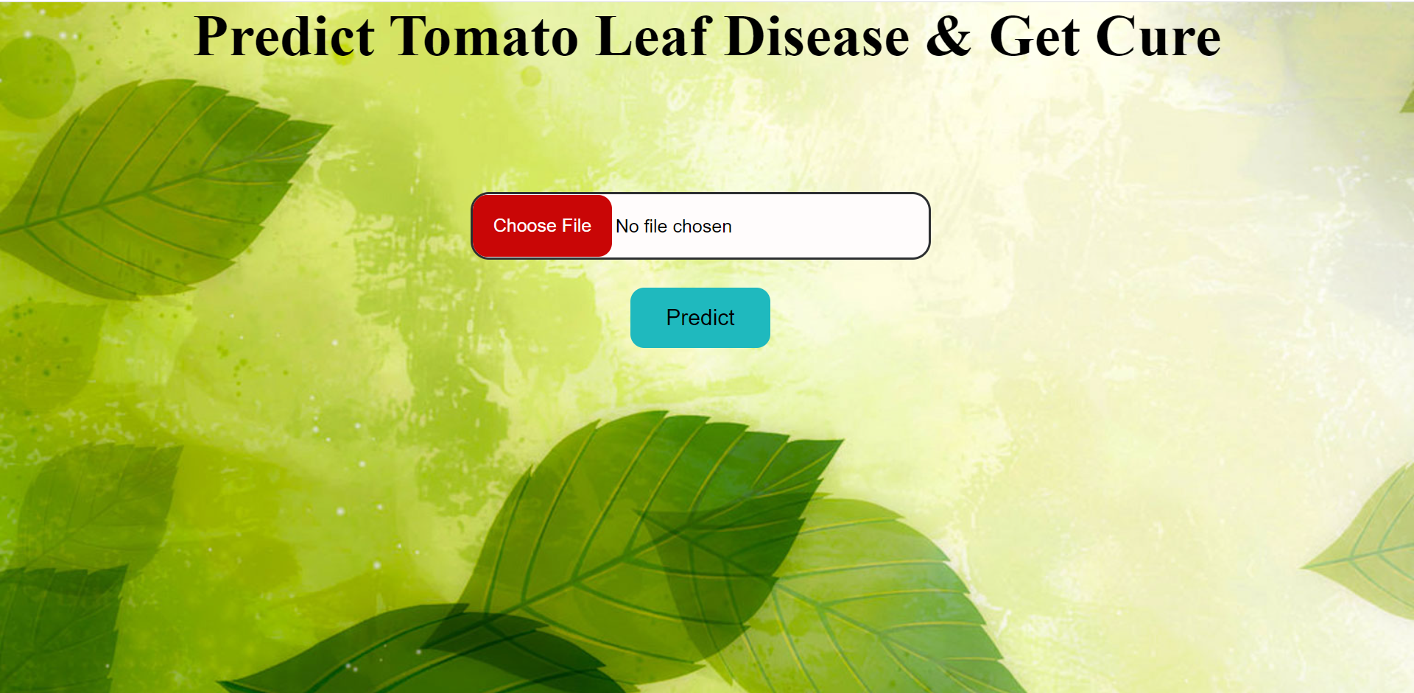
Presentation

Slide 12
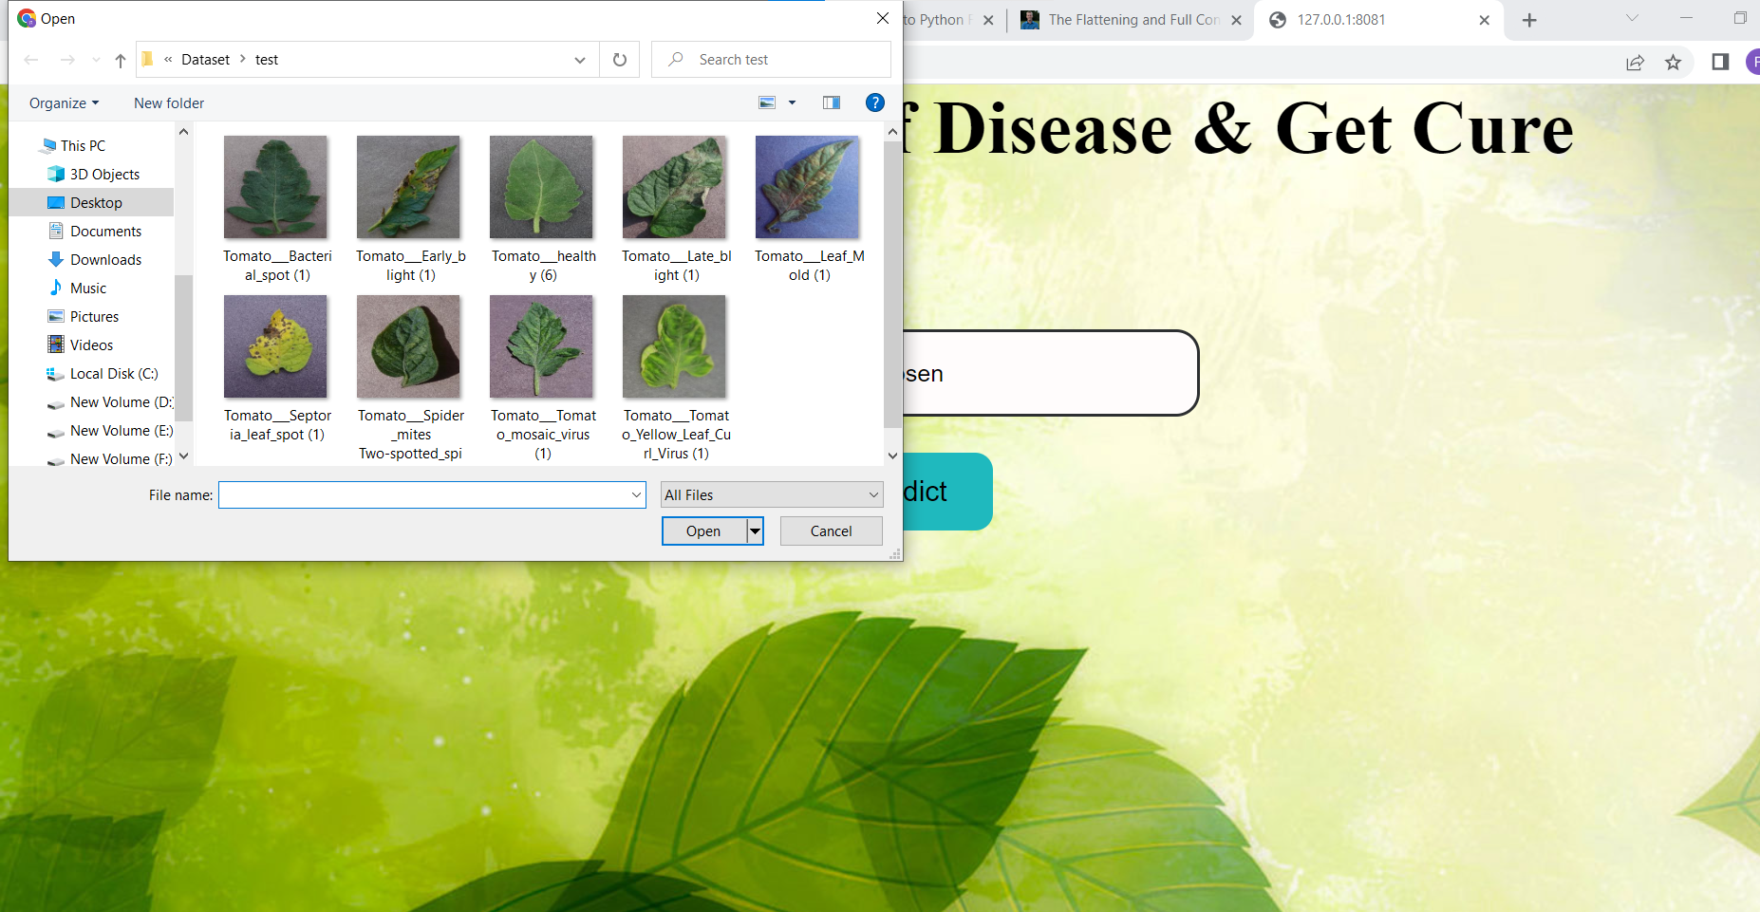

Slide 13
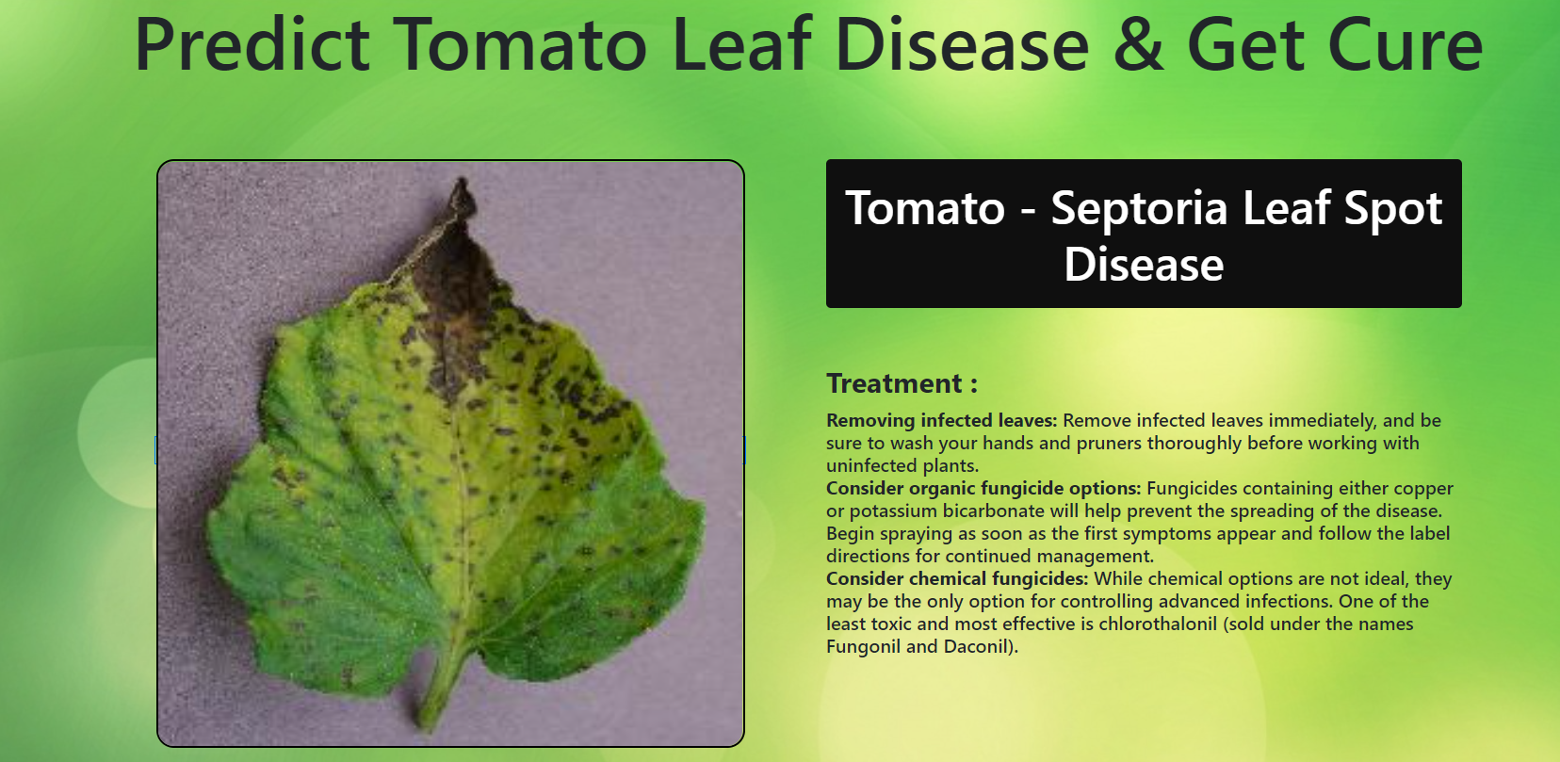

Slide 14
test cases
Test case Number | Test case name | Success/fail
1. | Image Upload | Successful
2. | Disease Identification | Successful
3. | Disease Cure display | Successful

Slide 15
Timeline

Slide 16
Thank you

